Slide 1
No Pies required today… ☺
Please sit in your project groups. Or form one now if you hadn’t. You can register your teams later online
Please note that you are required to make a Travel Declaration online
Should your plans change later on, you need to resubmit your travel declaration.

Slide 2
Open session with the class
Questions for discussion

Slide 3
What are the die-die must know things?
Python
Flowchart – graphical expression of an algorithm
Pseudocode --- informal way of expressing an algorithm
Boolean logic
Operators --- plus, minus, power, divide
Assignment --- assigning a value to a variable
Naming convention for variables
Notes:
Pseudocode
Flowcharts
The concept of an algorithm

Slide 4
Python
High-level programming language
Does not need compilation
Useful for quick development and implementation of “ideas” into code
Not memory efficient
Is popular now because of Tensorflow and other AI implementations
Not so good for statistical computing

Slide 5
Flowchart
Algorithm expressed as sequential steps
You think about where and how the data enters (input)
You think about decision points
You think about data transformation and processing
You think about when and where to output the information

Slide 6
Pseudocode
Algorithm expressed as an English “essay”
Less structured compared to flowcharts
But provides greater room for creativity!
Preferred mode of algorithm sharing because it is all about the idea, while leaving room for interpretation

Slide 7
Boolean logic
Decision points are based on Boolean logic
Boolean logic has only one of 2 outcomes: TRUE or FALSE
Test: It will rain today
Outcome: TRUE (will rain)
Outcome: FALSE (actually did not rain)

Slide 8
Operators
Processes that you can perform on your data
Addition (+)
Subtraction (-)
Multiplication (*)
Division (/)

Slide 9
Assignment
To give a value to something
Denoted by the “=” sign in Python
A = 10 is not A “equals” 10!
A = 10 means to assign the value of 10 to A

Slide 10
Variable naming conventions
Cannot start with a number
Cannot use a reserved/key word (e.g. if, else, )
Cannot use ?/+/- (only use alphanumeric)
Use an intuitive name for the variables

Slide 11
Ready?
Now let’s start the tutorial proper

Slide 12
1. A program allows a student to enter her numeric grade (an integer), and returns the letter grade, according to the following table. In case the grade is out of bounds, it returns "IMPOSSIBLE". Draw the flowchart and write the pseudocode for this program.

Slide 13
The desired input and output
Letter grade | Numeric grade
A | 10, 9
B | 8
C | 7
D | 6
F | 5,4,3,2,1,0

Slide 14
What do we know about flowcharts?
The shapes have specific meaning
The flow of the logic is indicated by arrows
Must have a start and end point
Decision points are used to model different paths

Slide 15
What do we know about flowcharts?
The shapes have specific meaning
The flow of the logic is indicated by arrows
Must have a start and end point
Decision points are used to model different paths

Slide 17
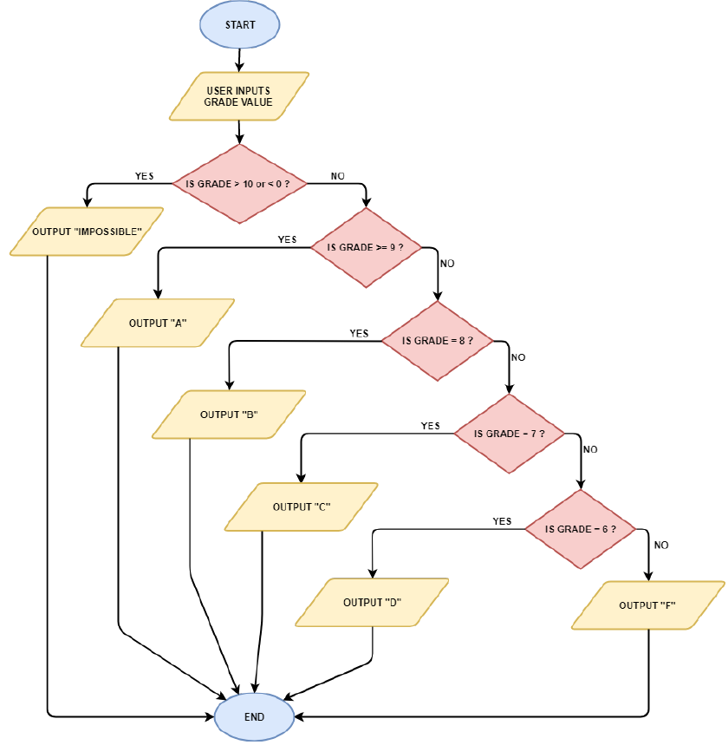

Slide 18
What do we know about pseudocode?
Informal expression of algorithm
Closer to English than any specific programming language

Slide 19

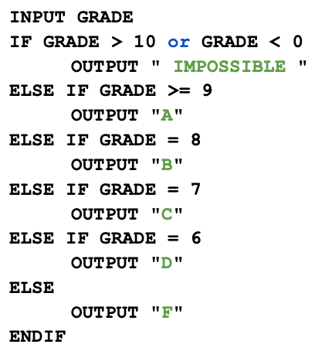
Pseudocode Example 1

Slide 20
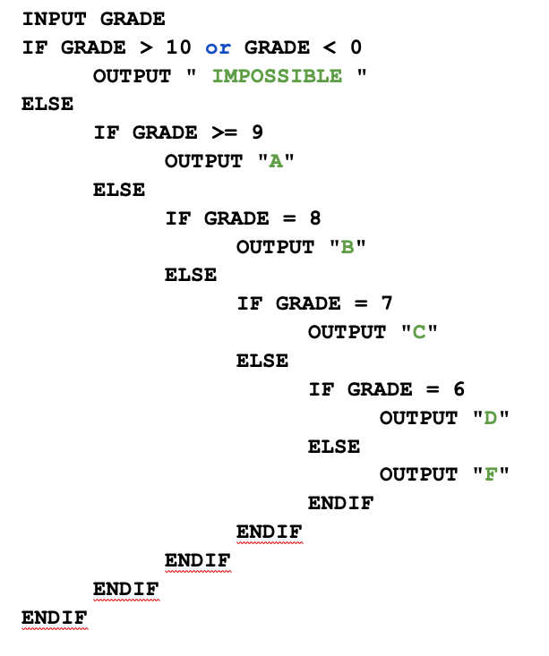
Pseudocode Example 2
Notes:
Is this closer to the idea represented by the flowchart?

Slide 21
5 minutes to discuss with your team mates
How different was your own solution?
How did your groupmates solve theirs?
Whose is more efficient?
Between the 2 pseudocodes, which one is closer to the idea represented by the flowchart?

Slide 22
2. Draw the flowchart and write the pseudocode of a program that asks the user to enter three values a, b and c, and that outputs the roots of the quadratic equation.
ax² + bx + c = 0

Slide 23
What do we know?
The number D = b² – 4ac determined from the coefficients of the equation ax² + bx + c = 0.
The discriminant reveals what type of roots the equation has.
A positive discriminant indicates that the quadratic has two distinct real number solutions.
A discriminant of zero indicates that the quadratic has a repeated real number solution.
A negative discriminant indicates that neither of the solutions are real numbers.

Slide 24
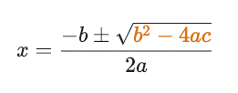
What do we know?
We can also solve for the roots x using the expression

Slide 25
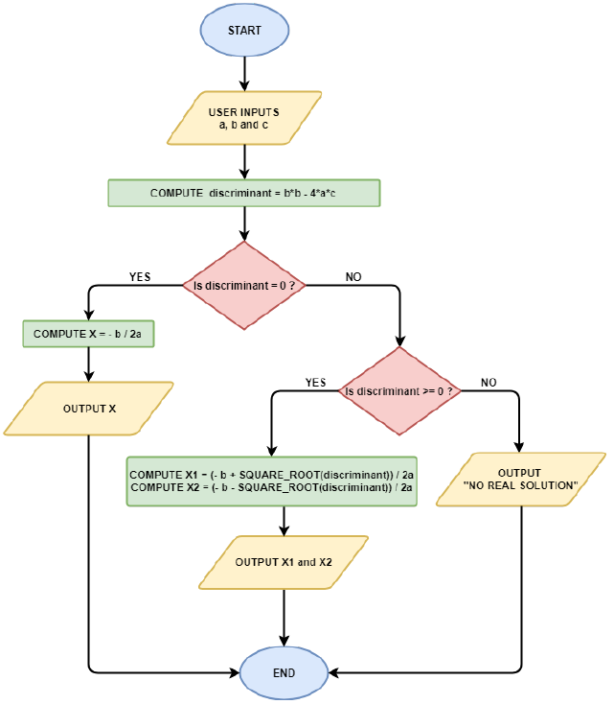

Slide 26
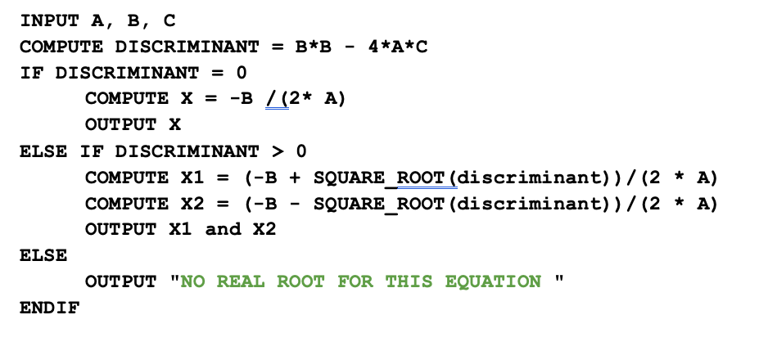
Pseudocode Solution

Slide 27

5 minutes to discuss with your team mates
How different was your own solution?
How did your groupmates solve theirs?
Whose is more efficient?

Slide 28
3. Imagine a user menu to order pizzas online.

Slide 29
What do we know?
The user is first asked to choose between 3 different types of pizzas (margherita: S$15.5, marinara: S$17.5 and napoletana: S$18).
Once the pizza type is selected, he is invited to type the amount of such pizzas he would like to order.
Finally, the user is asked if he would like to stop the ordering.
If not, then the menu comes back to asking to select the pizza type again.
If yes, the final price is printed according to the pizzas ordered and the program stops.

Slide 30
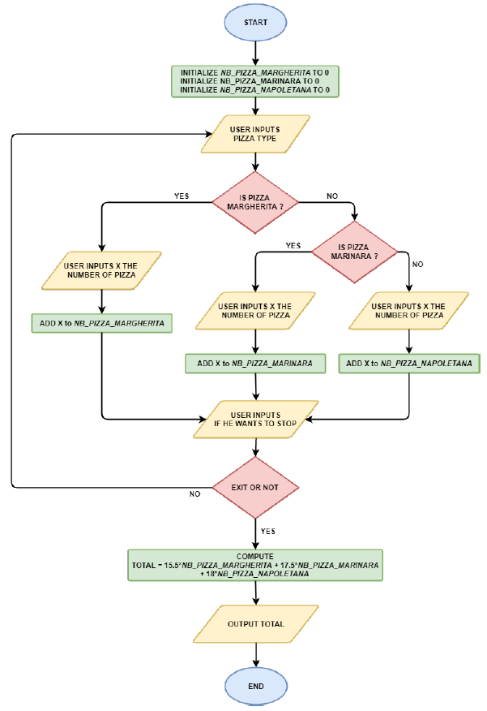

Slide 31
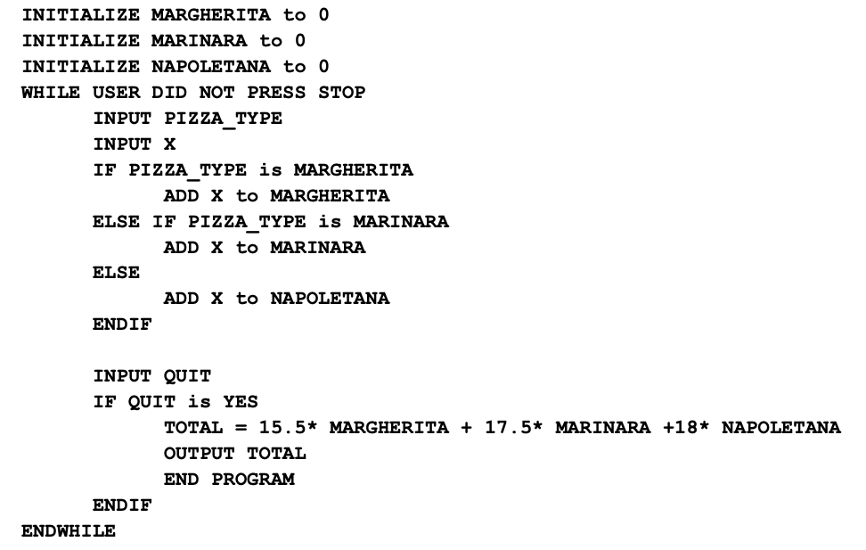
Notes:
The idea of a counter. Ask the class what initialize means

Slide 32
5 minutes to try
How different was your own solution?
How did your groupmates solve theirs?
Whose is more efficient?

Slide 33
4. The crime rate is the number of overall crime offences recorded per 100,000 total population. Write a Python program that takes as input 3 crime rate values and that outputs the average crime rate over the 3 values.

Slide 34
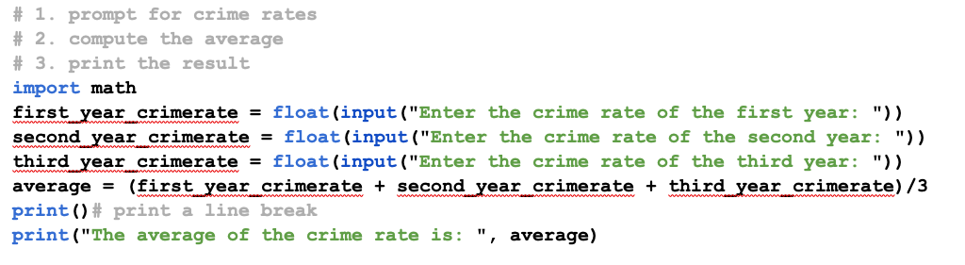
One potential solution in Python code
Notes:
Try getting yours to work now if you hadn’t gotten it.

Slide 35
5. What is the output of the following algorithm, if the user inputs X = 35 and Y = 10 (assume that the user always inputs X > 0 and Y > 0)? What is this algorithm computing?

Slide 36
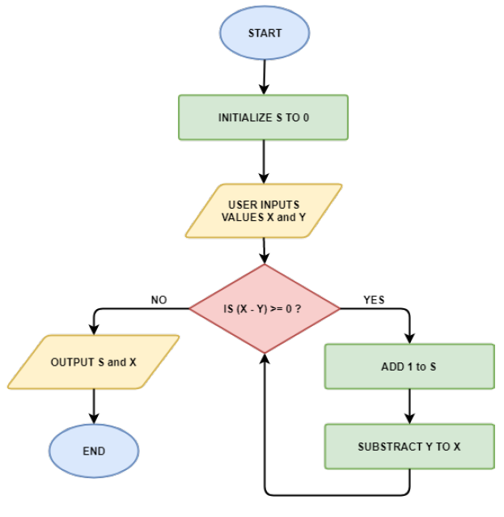
Notes:
When the user inputs X = 35 and Y = 10, the algorithm returns S = 3 and X = 5. This algorithm is simply computing the division of X by Y (the first output value is the division value, and the second output value is the reminder of the division).

Slide 37
6. What is the output of the following algorithm, if the user inputs X = 3 and Y = 8 (assume that the user always inputs X ≥ 0) ? What is this algorithm computing?

Slide 38
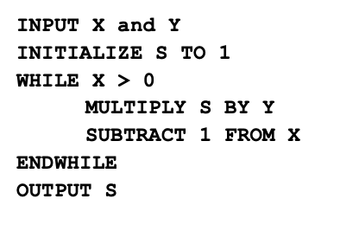
Notes:
When the user inputs X = 3 and Y = 8, the algorithm outputs S = 512. This algorithm is computing Y ^{X}.

Slide 39
The tabulation technique can help provide us some perspective
Round | X | Y | S | Comments
0 | x | y | 1 | Initialization state
1 | x - 1 | y | y | Round 1
2 | x - 2 |  | y * y = y² | Round 2 *by now you notice that y is invariant
3 | x - 3 |  | y * y² = y³ | You multiple a new y onto the pre-existing value in y
…. | … | … | … | …
x | x – x = 0 | y | y^{x} | stop condition
This is just a suggestion in terms of technique: You can interpret pseudocode in the best approach that suits yourselves.

Slide 40
5 minutes to try
How different was your own solution?
How did your groupmates solve theirs?
There is a slight flaw in this pseudocode. Can you spot it?

Slide 41
Break and practical
Today we will go through the practical together

Slide 42
A note
No RPis today.
Just use Spyder IDE on your desktops (or laptops)

Slide 43
1. Create a variable to store the molar mass of guanine (151.13)
Type this into the command line or script file:
guanine = 151.13

Slide 44
Create a variable myage and store your age in it. Subtract 5 from the value of the variable. Add 8 to the value of the variable. Print the final value contained in myage.
Solution (for age 38):
myage = 38
myage = myage - 5
myage = myage + 8
print(myage)
41

Slide 45
For each of the following commands, discuss what will be the outcome if they are executed by a Python interpreter, in this sequence:
a = d
c = 10
a = c + 1
a + c = c
3 + a
7up = 10
import = 1003
int = 500
a ** 3
b = math.pi * c
a,b,c = c,1,a
b,c,a = a,b
c = b = a = 7 print( A )
print( "b*b + a*a = c*c" )
print( "c" = 1 )

Slide 46
10 minutes to try
Try it in your groups

Slide 47
Outcome
a = d invalid, because d hasn’t been created/defined
c = 10 valid, Python statement
a = c + 1 valid, Python statement
a + c = c invalid, because LHS should be a variable

Slide 48
Outcome
3 + a valid, Python expression
7up = 10 invalid, Python naming convention: cannot start a variable name with digits
import = 1003 invalid, import is a reserved word in Python
int = 500 valid, int is not a reserved word in python, although it can be used to cast non-integer data type to integer. Not recommend to be used as name of variable to avoid ambiguity.
a ** 3 valid, Python expression

Slide 49
Outcome
b = math.pi * c invalid, we need ‘‘import math’’ for math module
a,b,c = c,1,a valid, Python statement for multiple assignment
b,c,a = a,b invalid, different number of elements on the two sides: LHS and RHS
c = b = a = 7 valid, Python allows chained assignment even though b is just created in the middle
print( A ) invalid, A not defined (Python: case sensitive)
print( "b*b + a*a = c*c" ) valid, Python statement
print( "c" = 1 ) invalid, because we cannot assign 1 to c and then do print in a single Python statement

Slide 50
3. Using the help function
The help() function is useful when you want to find information about a function, a Python module, and others. To try it out, import the math module and use the function help to display information about this module. Then, using this help, find and use the function from the math module that computes the hyperbolic sine of an angle in radian.

Slide 51
3. Using the help function
Try:
import math
help(math)
help(math.sinh)
math.sinh(1)
1.1752011936438014
Look at the various outputs. Take about 5-10 minutes to explore uses of the help function

Slide 52
4. Using methods
Each type in Python has specific attributes and methods that can be accessed using the dot (.) operator (to simplicity, view attributes and methods as functions).
For demonstrate, create a variable my_float with a float value. On Spyder, you can see the list of attributes and methods available for that variable by typing my_float and then pressing the tab key on your keyboard. Alternatively, you can list it by typing the command dir(my_float).

Slide 53
4. Using methods For example, the float type has a method as_integer_ratio() that decomposes the float as a ratio of two integers:
my_float=0.25
my_float.as_integer_ratio()
(1, 4)

Slide 54
Methods: To try
Explore the attributes and methods of the string type and then find and use the method that converts your string to uppercase.
Use this to get you started:
help(str)
help(str.upper)

Slide 55
Methods: To try
help(str)
help(str.upper)
my_string = "Hello world"
my_string.upper()
’HELLO WORLD’

Slide 56
Methods: To try
What does the method split do?
Notes:
help(str.split)

Slide 57
Methods: To try
S.split(sep=None, maxsplit=-1) -> list of strings
Return a list of the words in S, using sep as the delimiter string. If maxsplit is given, at most maxsplit splits are done.
If sep is not specified or is None, any whitespace string is a separator and empty strings are removed from the result.

Slide 58
Methods: To try
my_string = "Hello my name is John"
my_string.split()
[’Hello’, ’my’, ’name’, ’is’, ’John’]

Slide 59
5. More arithmetic operations
A farmer sells tomatoes and carrots. Current prices are 3.23 SGD/kg for tomatoes and 1.8 SGD/kg for carrots. The farmer produced 123kg of tomatoes and 247kg of carrots.
5.1 Write a script farmer.py, where you assign the prices to variables named tomato_price and carrot_price
Compute the amount of money earned by the farmer if he sells all its tomatoes and carrots, with one line of code
Compute the amount of money earned by the farmer if he sells 87% of its tomatoes and 67% of its carrots, with one line of code
The farmer has to pay 15% tax on his earnings from (5.3). Compute the amount of money received by the farmer after tax, with one line of code
Compute the same as (5.4), and round the total cost to the nearest dollar

Slide 60
10 minutes to try
Try it in your groups
If you have already done it. Compare and try reading your groupmates’ scripts
Did you all do it the same way?

Slide 61
Write a script farmer.py, where you assign the prices to variables named tomato_price and carrot_price
tomato_price = 3.29
carrot_price = 1.8

Slide 62
Compute the amount of money earned by the farmer if he sells all its tomatoes and carrots, with one line of code
123*tomato_price + 247*carrot_price

Slide 63
Compute the amount of money earned by the farmer if he sells 87% of its tomatoes and 67% of its carrots, with one line of code
0.87*123*tomato_price + 0.67*247*carrot_price

Slide 64
The farmer has to pay 15% tax on his earnings from (5.3). Compute the amount of money received by the farmer after tax, with one line of code
(0.87*123*tomato_price + 0.67*247*carrot_price)*(1-0.15)

Slide 65
Compute the same as (5.4), and round the total cost to the nearest dollar
int((0.87*123*tomato_price + 0.67*247*carrot_price)*(1-0.15))

Slide 66
Wilson’s Challenge
The algorithm PATTERNCOUNT uses strings Text and Pattern as input to generate the number COUNT(Text, Pattern) as its output.
For example, let Text be “TTTTATGTTTTATGTTTTATG”
And Pattern be “ATG”
COUNT(Text, Pattern) should return us 3.
Try to write an algorithm named PATTERNCOUNT that can perform the above

Slide 67
10 minutes to try
Try it in your groups
Let’s have someone show theirs

Slide 68
PATTERNCOUNT
Start
Start from the first position of Text and check whether Pattern appears in Text starting at its first position.
If yes, draw a dot on a piece of paper.
Move
Move to the second position of Text and check whether Pattern appears in Text starting at its second position.
If yes, draw another dot on the same piece of paper.
Continue
Continue until you reach the end of Text.
Count
Count the number of dots on the paper.
Notes:
Such an algorithm could comprise of 4 simple steps.
First, we initiate a counter from the first position of the text. This is similar to the start condition of the bubble sort algorithm.
At this position, you run a check for a pattern. If the pattern is identified, add 1 to a counter. If not, do nothing.
Then you move to the next position.
This will continue onwards until you reach the end of the text.
At which point, you return the final output, which is the count of the string patterns found along a piece of text.
Such an algorithm could be useful in biology. Suppose the pattern is ACTG, and we are looking for the numbers of this pattern along the length of a DNA sequence...

Slide 69
PATTERNCOUNT is an example of a motif search algorithm
These are very useful in biology e.g. looking for DNA binding locations

Slide 70
The end!

